Slide 1

ADAC Year 8 First Quarter Quarterly Review
...Via Conference Call, 04 October 2021
ADAC Project Briefing
Alaska and Arctic Maritime Communications and Connectivity Analysis
AAMC&CA Project Investigators:
Dr. Doug Causey, Dr. Mark Ivey, Mr. Jason Roe

Slide 2
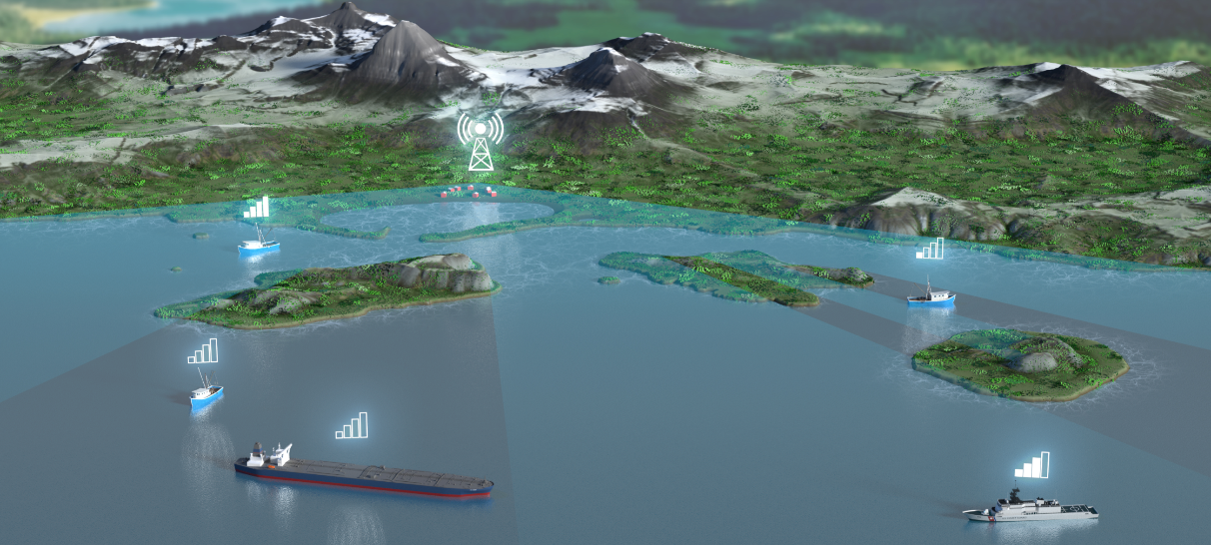

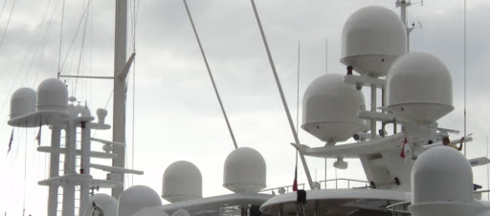
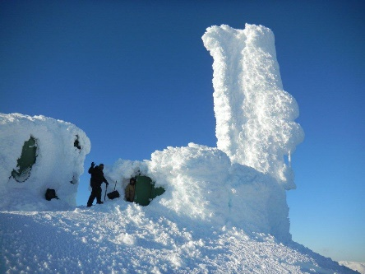
ADAC Project: Alaska and Arctic Maritime Communications and Connectivity Analysis
ADAC Program Year 8 First Quarter Quarterly Review 23-24 September 2021
Principal Investigators:
Dr. Doug Causey, ADAC Principal Investigator, University of Alaska Anchorage (UAA)
Mr. Jason Roe, USCG (Ret), ADAC Associate Director & SRP, University of Alaska Anchorage (UAA)
Dr. Mark Ivey Sandia National Laboratories, Albuquerque NM
Project Champion:
CDR Sam Nassar, HQ USCG CG761, Washington D.C.
Technical researchers:
Mr. Bruce Heinrich, Arctic Slope Regional Corporation (ASRC) Federal Mission Solutions (ASRC FMS).
Mr. Greg Stihel and Mr. Matthew Ahlrichs, Sandia National Laboratories, Albuquerque NM.
CAPT Buddy Custard, USCG (Ret), Alaska Marine Prevention and Response Network, Juneau, AK.
CAPT Ed Page, USCG (Ret), Marine Exchange of Alaska, Juneau AK.
Ms. Ellee Matthews, ADAC Education and Administrative Manager.
Mr. Connor Keesecker, ADAC Communications and Research Associate.
Ms. Kelsey Frazier, ADAC Research Associate, UAA, Anchorage, AK.
Mr. Wade Albright, Alaska Satellite Facility, University of Alaska Fairbanks (UAF), Fairbanks, AK.

Slide 3

ADAC Project: Alaska and Arctic Maritime Communications and Connectivity Analysis
ADAC Program Year 8 First Quarter Quarterly Review 23-24 September 2021
Arctic community outreach coordinators:
Mr. Nagruk Harcharek, Ukpeaġvik Iñupiat Corporation, Utqiaġvik, AK.
Project Stakeholders:
Mr. Shannon Jenkins, Senior Arctic Policy Advisor, HQ USCG 5PW, Washington D.C.
CAPT Russel “Rusty” Dash, HQ USCG CG51, Washington D.C.
Mr. Al Arsenault, Chief Technical Director, USCG R&D Center, New London CT.
Mr. Phil Thorne, Arctic Planner, USCG District 17, Juneau, AK.
LCDR Jereme Altendorf, USCG District 17 Sector Anchorage, AK.
Dr. Phil McGillivary, Science Advisor USCG Pac Area, Alameda CA.
Project Advisors:
Mr. Joe Hersey, USCG Civ. (Ret), RTCM Board Vice chair, GMDSS Task Force
Mr. Taylor Holshouser, Alaska Ocean Cluster, Anchorage AK.
Mr. Ken Flowers, Vice President, Government Solutions Iridium Corporation, McLean VA.
Mr. Bruce Hellenga, Operations Manager, ARCTICOM, LLC, Bering Straits Native Corporation, Anchorage AK.
Current Student Participation:
Mr. Talha Ali, ADAC Fellow, University of Alaska Anchorage

Slide 4

Alaska and Arctic Maritime Communications and Connectivity Analysis:
Description
ADAC Program Year 8 First Quarter Quarterly Review 23-24 September 2021
Project Description:
To understand and assess the communication and connectivity challenges unique to the Alaskan and the U.S. Arctic maritime regions through a comprehensive review of mariner communications and connectivity needs, with a focus on near, mid-term, and long-term time horizons.
To provide an in-depth analysis of emerging technologies, and identify solutions that meet the needs and address the challenges of Alaskan and Arctic mariners
To support the public good by addressing marine communications and connectivity needs that affect mariner and Coastal communities across Alaska and the Arctic.

Slide 5
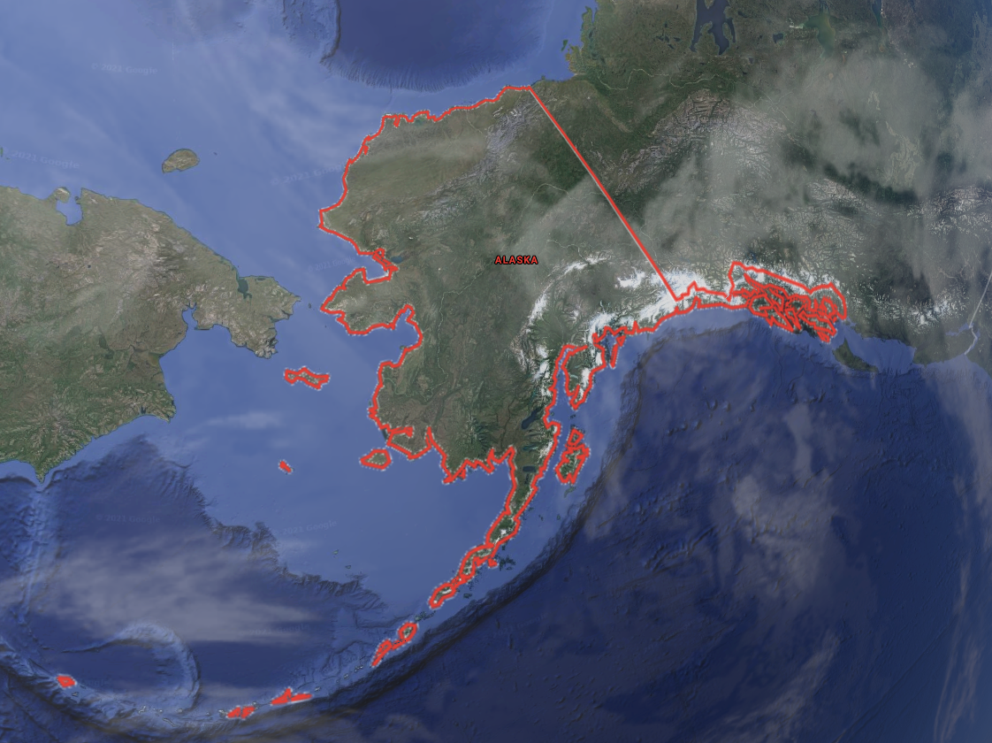
Alaska and Arctic Maritime Communications and Connectivity Analysis:
Baseline
ADAC Program Year 8 First Quarter Quarterly Review 23-24 September 2021
Project Baseline:
Many Alaskan and Arctic mariners, including commercial and industry operators, subsistence hunters, and hundreds of village communities, continue to operate in a largely communications deprived environment, unable to connect ship-to-shore or, ship-to-aircraft (and vice versa), for weeks at a time.
From the 2019 USCG Arctic Strategic Outlook: “The high latitudes suffer from poor propagation of radio signals, geomagnetic interference, scant landside infrastructure, and limited satellite coverage and bandwidth. Some Arctic communities have cellular phone networks, but these are often constrained by limited coverage, capacity, and reliability. Closing the communications gap is a whole-of-government challenge and will require intensive partnerships across the interagency, industry, and the international community, as well as the State of Alaska and Alaska Native communities.”

Slide 6
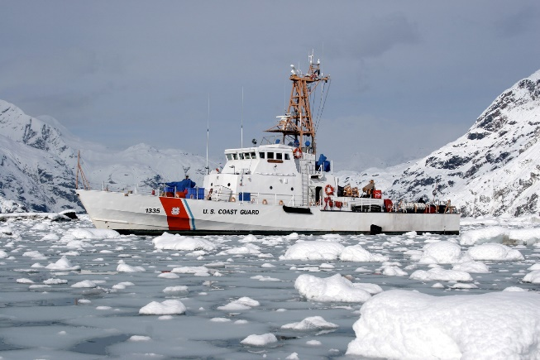
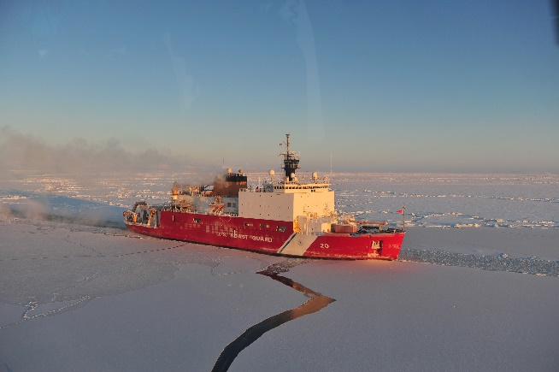
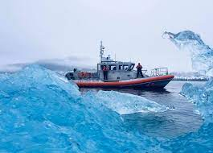
ADAC Program Year 8 First Quarter Quarterly Review 23-24 September 2021
Alaska and Arctic Maritime Communications and Connectivity Analysis:
Relevance
Reliable and effective communications with mariners is essential to all USCG mission areas.
  Reliable and effective communications with/among mariners:
    Reduces risk to mariners (Notice to mariners, safety broadcasts, weather broadcasts)
    Saves lives (Effective emergency response, alerting Good Samaritans)
    Increases Domain Awareness (mariner observations and reporting of pollution & obstructions)
    Reduces risks to responders (increased situational awareness, shortened search time, proper response resources)
    Protects the environment (fast and accurate reports of spills speed up response times and reduce amount of discharge)
    Reduces USCG investigative workload (Reports of Overdue mariners, shortens and increases the effectiveness of interviews)

Slide 7
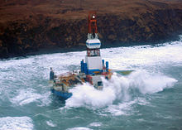
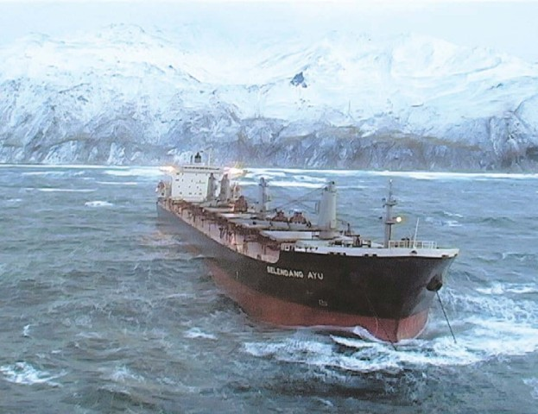
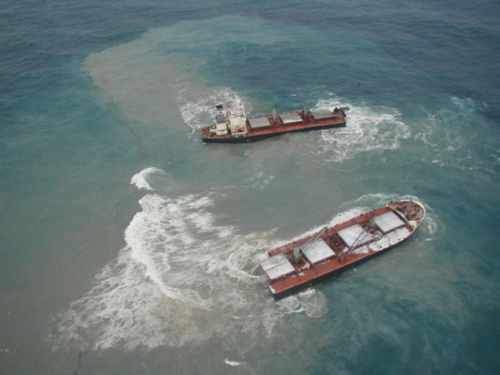
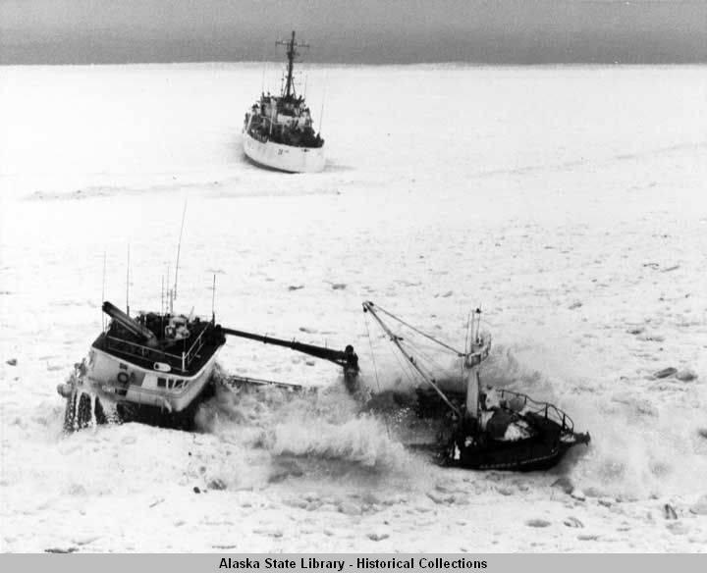
ADAC Program Year 8 First Quarter Quarterly Review 23-24 September 2021
Alaska and Arctic Maritime Communications and Connectivity Analysis:
Relevance

Slide 8
ADAC Program Year 8 First Quarter Quarterly Review 23-24 September 2021
Alaska and Arctic Maritime Communications and Connectivity Analysis:
Method
Research Method:
This project includes:
  a comprehensive review of mariner communications and connectivity needs for Alaska and the U.S. Arctic,
  a focus on near, mid-term, and long-term time horizons.
  leveraging a sequenced and iterative approach, with each phase informing subsequent research
    literature review
    establishment of a Core Advisory Team
    establishment of project working groups.
  the development of an in-depth market survey which will serve as the primary data-gathering stage
  the creation of a draft knowledge product
  a final capstone workshop to assess the draft knowledge product.
  the finalization of a comprehensive final knowledge product.

Slide 9
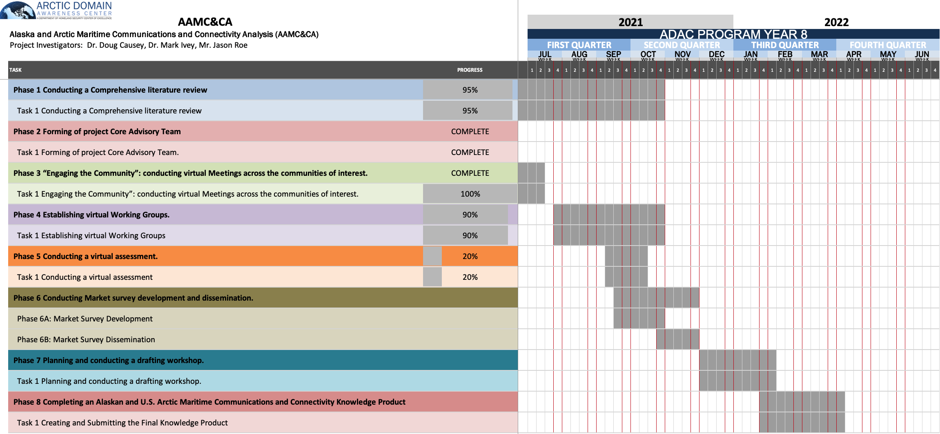
ADAC Program Year 8 First Quarter Quarterly Review 23-24 September 2021
Alaska and Arctic Maritime Communications and Connectivity Analysis:
Schedule
As/of 22 Sep 2021

Slide 10
ADAC Program Year 8 First Quarter Quarterly Review 23-24 September 2021
Alaska and Arctic Maritime Communications and Connectivity Analysis:
Phase 1: Conducting a comprehensive literature review 95% complete
Literature review is in production and is oriented to identify the gaps and shortfalls of existing communications and connectivity systems in the U.S. Arctic
  First draft completed by the ADAC office with outstanding support from ADAC Fellows
  Second draft in progress and is currently a working document to be utilized during virtual assessment
  Literature Review will be finalized after Virtual assessment scheduled for 12-14 October 2021

Slide 11
ADAC Program Year 8 First Quarter Quarterly Review 23-24 September 2021
Alaska and Arctic Maritime Communications and Connectivity Analysis:
Phase 2: Forming the project Core Advisory team completed
AAMC&CA Core Team has been formed and regular meetings are underway.
The Core team will ensure the Project Investigators are meeting the goals and objectives of the project. Throughout the duration of the project, members of the Core Team will continue to participate in virtual assessments and will be able to listen to all working group meetings. The Core Team will review/edit all documents produced during the project, including the final knowledge product.
  AAMC&CA Core Team currently has 32 members
  Team has conducted 10 meetings, with the 11th meeting planned for 18 October 2021

Slide 12
ADAC Program Year 8 First Quarter Quarterly Review 23-24 September 2021
Alaska and Arctic Maritime Communications and Connectivity Analysis:
Phase 3: Engaging the Community meetings completed
AAMC&CA Engaging the Community meetings completed
  The Core Team with key project stakeholders will seek to clearly establish Alaskan and Arctic maritime communication and connectivity needs, and to define the scope of project for stakeholders.
  Region 1: Southeast Alaska.
  Region 2: Southcentral Alaska (extending from Cordova to Kodiak, including Prince William Sound and Cook Inlet).
  Region 3: Alaska Peninsula and Aleutian Islands.
  Region 4: Bering Sea (extending from Bristol Bay Northward to Bering Straits, to include Norton Sound).
  Region 5: Chukchi Sea.
  Region 6: Beaufort Sea.

Slide 13
ADAC Program Year 8 First Quarter Quarterly Review 23-24 September 2021
Alaska and Arctic Maritime Communications and Connectivity Analysis:
Phase 4: Establishing virtual Working Groups 90% complete
AAMC&CA virtual Working Groups have been defined and the first Working Groups meetings took place in July 2021
  The Core Team with key project stakeholders will seek to clearly establish Alaskan and Arctic maritime communication and connectivity needs, and to define the scope of project for stakeholders.
  Working groups will seek to grow stakeholder participation during the Virtual Assessment 12-14 October 2021
  Arctic Region Working Group
  Non-Arctic Region Working Group
Working Group Tasks:
Grow stakeholder participation in Working groups
Validate critical AAMC&CA (Arctic and Non-Arctic) needs questions:
Validate (Arctic and Non-Arctic) User Stories:
Identify (Arctic and Non-Arctic) key technology types:
Identify Key (Arctic and Non-Arctic) Working Group technology presentations:
Validate/streamline proposed initial Market Survey Questions

Slide 14
ADAC Program Year 8 First Quarter Quarterly Review 23-24 September 2021
Alaska and Arctic Maritime Communications and Connectivity Analysis:
Phase 5: Conducting a Virtual Assessment 20% complete
Dates: 12-13-14 October 2021, Tues, Wed, Thurs.
8:00 -12:30 Alaska Time
  Day 1: Virtual Panels 3 types of panels USCG, Industry, Stakeholders
    provide preliminary discussion and added context for Day 2 Virtual Breakout Groups
    to engage and encourage robust industry participation in follow-on activities
  Day 2: Breakout Group assessments, rotating all groups through each of the below
    Current and near-term Alaskan and U.S. Arctic maritime connectivity technologies.
    Medium- and long-term Alaskan and U.S. Arctic maritime connectivity technologies.
    Connectivity transition, utilization, and integration strategies and
pathways.
  Day 3: Breakout Group Presentations and Survey Question Development
    Each breakout group will also develop approximately 20 potential questions to be included in the follow-on stakeholder market survey

Slide 15
ADAC Program Year 8 First Quarter Quarterly Review 23-24 September 2021
Alaska and Arctic Maritime Communications and Connectivity Analysis:
Preliminary Research Summary:
Communications challenges include:
Sparse, limited, and outdated infrastructure
Mountainous terrain
Unpredictable weather
Extreme environmental conditions
Remote and difficult to reach locations
High maintenance costs
Significant logistics challenges
Bears…

Slide 16
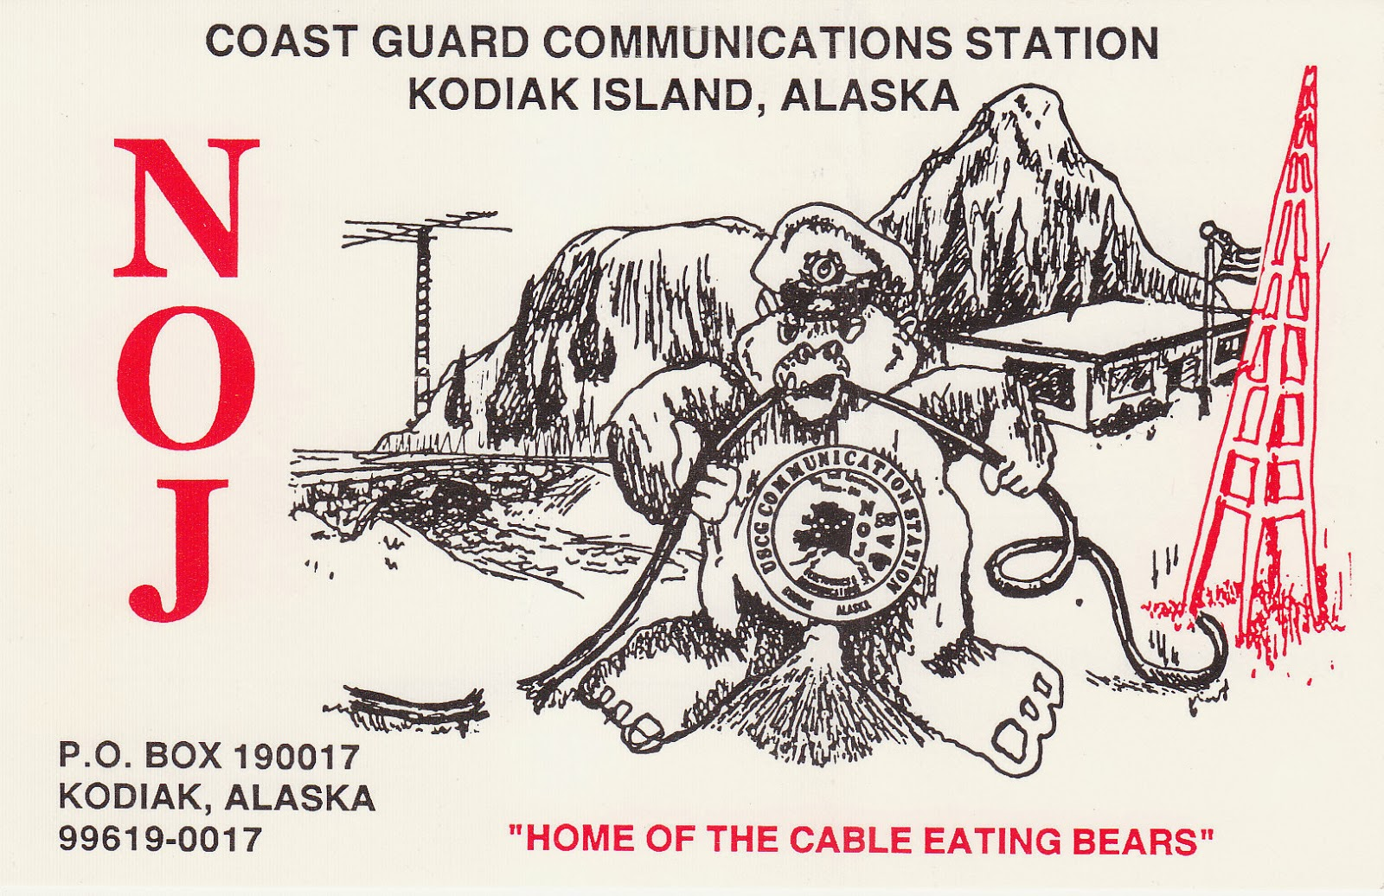
ADAC Program Year 8 First Quarter Quarterly Review 23-24 September 2021
Alaska and Arctic Maritime Communications and Connectivity Analysis:

Slide 17
ADAC Program Year 8 First Quarter Quarterly Review 23-24 September 2021
Alaska and Arctic Maritime Communications and Connectivity Analysis:
Communications Regions study
  Region 1: Southeast Alaska.
  Region 2: Southcentral Alaska (extending from Cordova to Kodiak, including Prince William Sound and Cook Inlet).
  Region 3: Alaska Peninsula and Aleutian Islands.
  Region 4: Bering Sea (extending from Bristol Bay Northward to Bering Straits, to include Norton Sound).
  Region 5: Chukchi Sea.
  Region 6: Beaufort Sea.

Slide 18
ADAC Program Year 8 First Quarter Quarterly Review 23-24 September 2021
Alaska and Arctic Maritime Communications and Connectivity Analysis:
Southeast Alaska Region:
Regional vessel traffic characterized by:
Frequent Large passenger vessel and Cruise Ship traffic during summer months
A large amount of small fishing vessels
Regular tug and barge traffic
A large amount of recreational vessel traffic
Image courtesy of Marine Exchange of Alaska

Slide 19
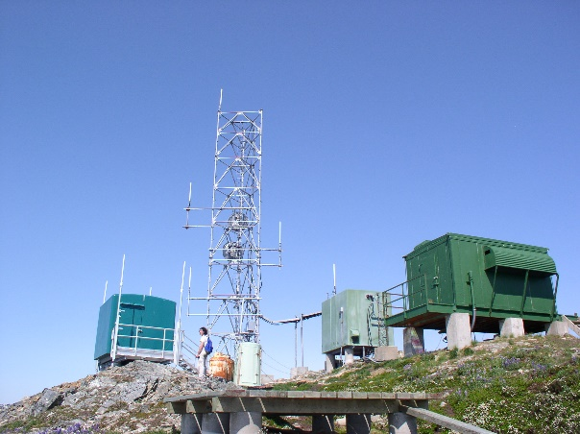
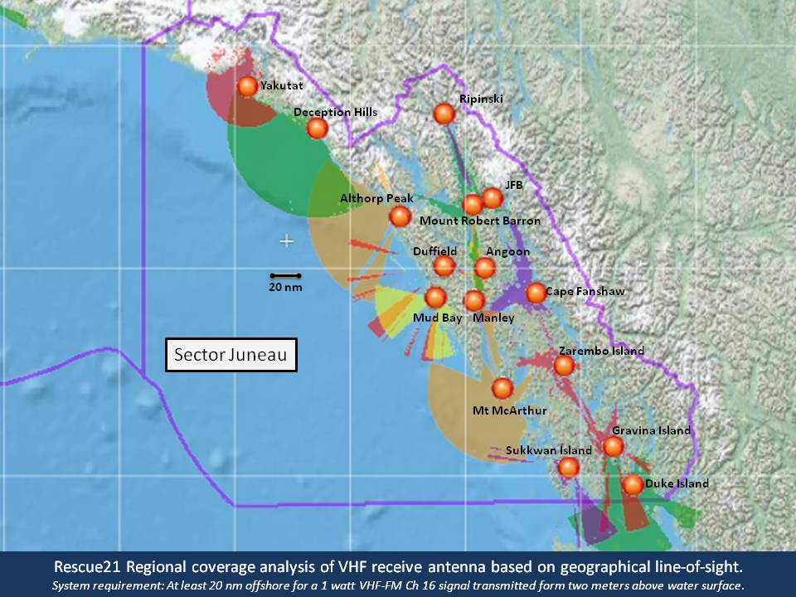

ADAC Program Year 8 First Quarter Quarterly Review 23-24 September 2021
Alaska and Arctic Maritime Communications and Connectivity Analysis:
Southeast Alaska Region:
Regional communications challenges characterized by:
Small fishing vessels and recreational vessels that frequently transit VHF dead zones
VHF RFF/Site outages
VHF is most widely used communications method followed by cell phones
Satellites/Satellite communications blocked/disrupted by mountainous terrain
Unreliable Satellite speed of service
Sat phones and HF used only on larger vessels

Slide 20
ADAC Program Year 8 First Quarter Quarterly Review 23-24 September 2021
Alaska and Arctic Maritime Communications and Connectivity Analysis:
Southeast Alaska Region:

Slide 21
ADAC Program Year 8 First Quarter Quarterly Review 23-24 September 2021
Alaska and Arctic Maritime Communications and Connectivity Analysis:
Southcentral Alaska Region:
Regional vessel traffic characterized by:
Some Large passenger vessel and Cruise Ship traffic during summer months
A large amount of small fishing vessels
Regular tug and barge traffic
A large amount of recreational vessel traffic
Tanker traffic into Valdez and Cook Inlet
Image courtesy of Marine Exchange of Alaska

Slide 22
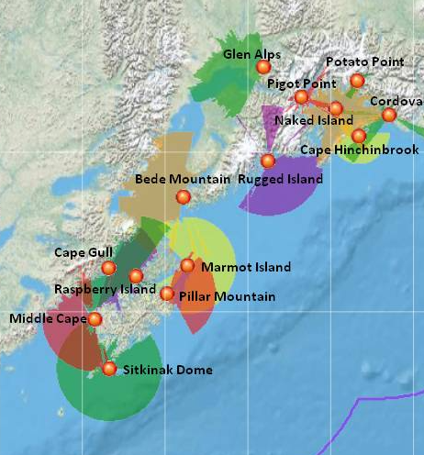
ADAC Program Year 8 First Quarter Quarterly Review 23-24 September 2021
Alaska and Arctic Maritime Communications and Connectivity Analysis:
Southcentral Alaska Region:
Regional communications challenges characterized by:
Small fishing vessels and recreational vessels that frequently transit VHF dead zones
VHF outages
VHF is most widely used communications method followed by cell phones
Satellites/Satellite communications blocked/disrupted by mountainous terrain
Unreliable Satellite speed of service
Sat phones and HF used only on larger vessels
Several large weather forecast regions with differing conditions, ie PWS and Shelikof Strait
Glacial Fog and narrow waterways
Mariners with satellite service now use WhatsApp
  Info groups can be established

Slide 23
ADAC Program Year 8 First Quarter Quarterly Review 23-24 September 2021
Alaska and Arctic Maritime Communications and Connectivity Analysis:
Southcentral Alaska Region:

Slide 24
ADAC Program Year 8 First Quarter Quarterly Review 23-24 September 2021
Alaska and Arctic Maritime Communications and Connectivity Analysis:
Alaska Peninsula and Aleutian Island Region:
Regional vessel traffic characterized by:
High volume of foreign deep-draft vessel traffic
Large Fishing vessels
Very few passenger vessels and recreational vessels
Image courtesy of Marine Exchange of Alaska

Slide 25
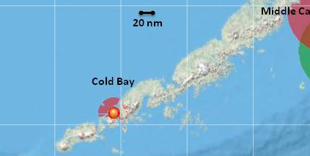
ADAC Program Year 8 First Quarter Quarterly Review 23-24 September 2021
Alaska and Arctic Maritime Communications and Connectivity Analysis:
Alaska Peninsula and Aleutian Island Region :
Regional communications challenges characterized by:
Almost no VHF infrastructure
Very remote region with great distances
Most vessels utilize HF, Satellite Communications, and AIS
Vessel contact difficult via Sat phone
AIS monitoring of foreign vessel traffic labor-intensive
Frequent severe weather
Need for greater fidelity with air temperature in marine broadcasts to assist with mitigating icing

Slide 26
ADAC Program Year 8 First Quarter Quarterly Review 23-24 September 2021
Alaska and Arctic Maritime Communications and Connectivity Analysis:
Bering Sea Region:
Regional vessel traffic characterized by:
Large volume of large fishing vessels
Large volume of small fishing vessels near shore
Moderate amount of tank vessels
Moderate amount of tugs
Small recreational vessels traveling great distances offshore
Image courtesy of Marine Exchange of Alaska

Slide 27
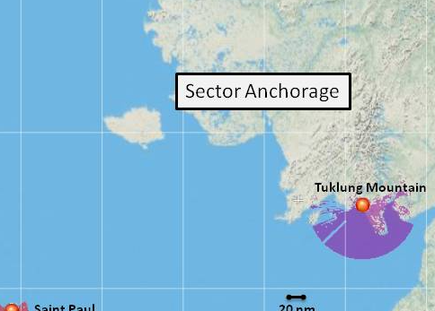
ADAC Program Year 8 First Quarter Quarterly Review 23-24 September 2021
Alaska and Arctic Maritime Communications and Connectivity Analysis:
Bering Sea Region:
Regional communications challenges characterized by:
Only one USCG VHF site (Tuklung Mountain)
Congested waterways in southern and northern parts of the region
Bering strait is a narrow international waterway with safety concerns
No VHF weather broadcasts in northern Bering Sea
Need for greater fidelity with air temperature in marine broadcasts to assist with mitigating icing
Mariners with satellite service now use WhatsApp
  Info groups can be established

Slide 28
ADAC Program Year 8 First Quarter Quarterly Review 23-24 September 2021
Alaska and Arctic Maritime Communications and Connectivity Analysis:
Chukchi Sea Region:
Regional vessel traffic characterized by:
Most vessels transit near to shore
Moderate amount of Tug traffic
Small subsistence and recreational vessels travel great distances from shore
Image courtesy of Marine Exchange of Alaska

Slide 29
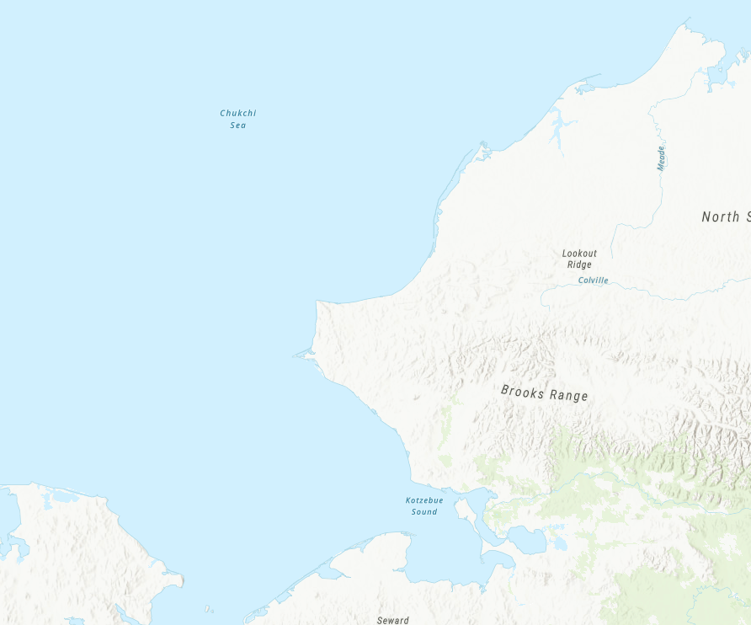
ADAC Program Year 8 First Quarter Quarterly Review 23-24 September 2021
Alaska and Arctic Maritime Communications and Connectivity Analysis:
Chukchi Sea Region:
Regional communications challenges characterized by:
No USCG VHF site
Congested waterways in southern part of the region
No VHF weather broadcasts
VHF becomes a ‘party line” during subsistence activities
NWS has need for weather observations

Slide 30
ADAC Program Year 8 First Quarter Quarterly Review 23-24 September 2021
Alaska and Arctic Maritime Communications and Connectivity Analysis:
Beaufort Sea Region:
Regional vessel traffic characterized by:
Moderate amount of Tug traffic
Small subsistence and recreational vessels travel great distances from shore
Image courtesy of Marine Exchange of Alaska

Slide 31
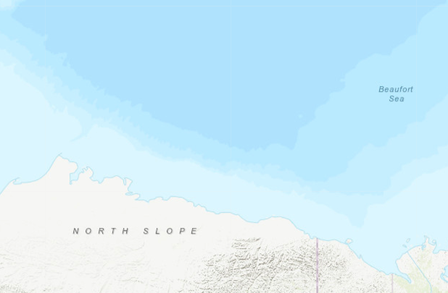
ADAC Program Year 8 First Quarter Quarterly Review 23-24 September 2021
Alaska and Arctic Maritime Communications and Connectivity Analysis:
Beaufort Sea Region:
Regional communications challenges characterized by:
No USCG VHF site
No VHF weather broadcasts
VHF becomes a ‘party line’ during subsistence activities
NWS has need for weather observations

Slide 32
ADAC Program Year 8 First Quarter Quarterly Review 23-24 September 2021
Alaska and Arctic Maritime Communications and Connectivity Analysis:
Planned Research Outcomes:
A comprehensive knowledge product that includes:
A review of the current state-of-the-art Alaskan and U.S. Arctic maritime communications and connectivity technologies.
Recommendations and conclusions for near-term available state-of-the-art Alaskan and U.S. Arctic maritime communications and connectivity technologies suitable for USCG use.
Recommendations and conclusions for medium-and-long term future Alaskan and U.S. Arctic maritime communication and connectivity technologies.
Detailed recommendations and conclusions on Alaskan and U.S. Arctic maritime communications connectivity transition pathways (focused on Alaskan and U.S. Arctic maritime regions.

Slide 33
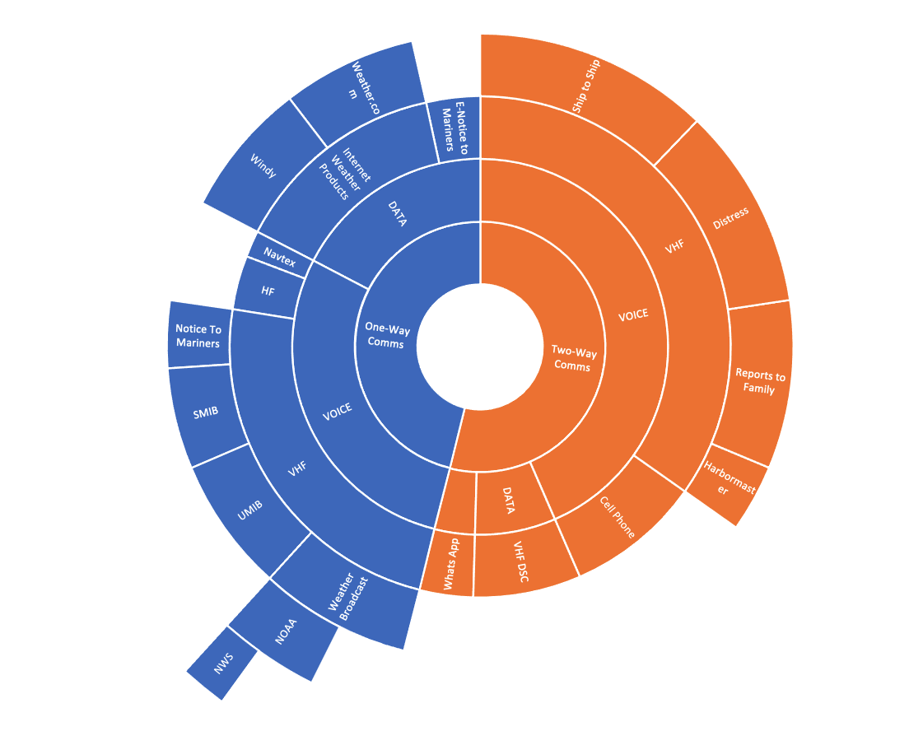
ADAC Program Year 8 First Quarter Quarterly Review 23-24 September 2021
Alaska and Arctic Maritime Communications and Connectivity Analysis:
Planned Research Outcomes:
A comprehensive knowledge product
that includes:
Alaska and Arctic maritime
operator User Stories

Slide 34

ADAC Program Year 8 First Quarter Quarterly Review 23-24 September 2021
Alaska and Arctic Maritime Communications and Connectivity Analysis:
Planned Research Outcomes:
A comprehensive knowledge product that includes:
Alaska and Arctic maritime Technology Matrix

Slide 35
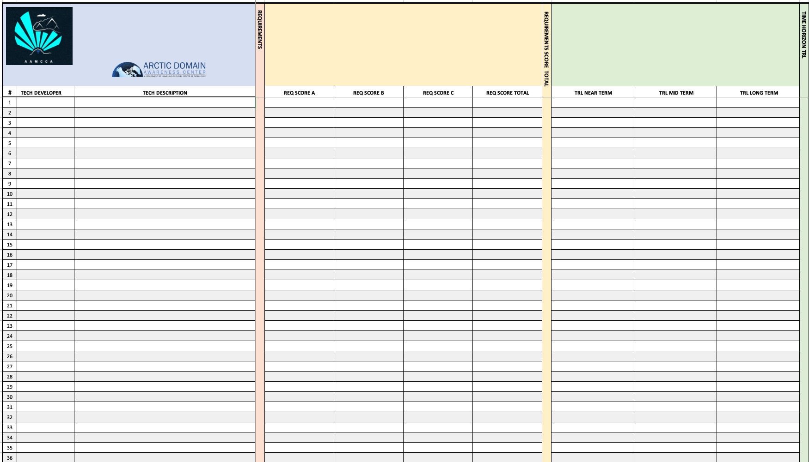
ADAC Program Year 8 First Quarter Quarterly Review 23-24 September 2021
Alaska and Arctic Maritime Communications and Connectivity Analysis:
Planned Research Outcomes:
A comprehensive knowledge product that includes:
Alaska and Arctic maritime Technology Matrix

Slide 36
ADAC Program Year 8 First Quarter Quarterly Review 23-24 September 2021
Alaska and Arctic Maritime Communications and Connectivity Analysis:
Key Accomplishments:
Conducted project kickoff meeting
Formed Core Team
Completed Second draft of literature review
Completed 36 Engaging the community meetings
Completed 10 Core Team meetings
Established Arctic and non-Arctic working groups
Conducted 4 Working Group meetings
Scheduled Virtual Assessment – Planning in progress

Slide 37
ADAC Program Year 8 First Quarter Quarterly Review 23-24 September 2021
Alaska and Arctic Maritime Communications and Connectivity Analysis:
Carriage Requirements:
System | Description | Service type | Providing Agency
406 MHz EPIRB or PLB | Cospas-Sarsat satellite emergency position-indicating radiobeacon | Distress | NOAA/NESDIS
Rescue 21 | Voice | Distress and MSI | USCG
 | DSC | Distress
NOAA Weather Radio | Voice | MSI | NOAA
High Frequency (HF) | Voice (single sideband) | Distress and MSI | USCG
 | DSC | Distress
 | Weatherfax | MSI
 | HF NAVTEX | MSI
NAVTEX | Worldwide Coastal, English text | MSI | USCG
Inmarsat SafetyNET | Worldwide geostationary (GEO) satellite | MSI | NGA/NOAA/USCG
Iridium SafetyCAST | Worldwide low earth orbit (LEO) satellite | MSI | NGA/NOAA/USCG
Internet | Web (weather forecasts, harts and navigational warnings) | MSI | NGA/NWS/USCG
 | Email (weather forecasts and navigational warnings) | MSI | NWS/USCG

Slide 38
ADAC Program Year 8 First Quarter Quarterly Review 23-24 September 2021
Alaska and Arctic Maritime Communications and Connectivity Analysis:
Preliminary observations:
Identified need for NWS and Mariners to collaborate & better share information
  NWS expressed need for weather observations from mariners
    To help better understand local weather phenomena
    To potentially feed/improve models
  Mariners expressed need for spot forecasts
  Mariners identified several forecast areas as too large to be effective
  Mariners expressed a great need for more accurate air temperature information to prevent icing
VHF radio voice communications remains favored/first emergency communications method
  including areas well offshore and outside VHF range.
  Best/fastest way to notify nearest vessels potential Good Sam
WhatsApp is currently being utilized by mariners with mobile/underway broadband connectivity
  WhatsApp has the potential to utilize notification groups
Many smaller commercial vessels and small fishing vessels are unaware of complete suite of broadcasts
  NAVTEX
Some smaller commercial vessels and small fishing vessels have operational HF equipment onboard to be only used as a last resort

Slide 39
Ready for questions
ADAC Program Year 8 First Quarter Quarterly Review 23-24 September 2021
Feedback…
What are we missing?
What can we improve?
Who should we connect with to improve odds of research success?
Notes:
Thank you for the gift of your time and attention.

